Slide 1
"بسمه تعالی" پاسخ تمرین هشتم درس معماری کامپیوتر

Slide 2
سوال 1)الف: A = 011011 B = 000101
A0 | A1 | A2 | A3 | A4 | A5 | R0 | R1 | R2 | R3 | R4 | R5 | Action
1 | 1 | 0 | 1 | 1 | 0 | 0 | 0 | 0 | 0 | 0 | 0 | Shift left
 | 1 | 1 | 0 | 1 | 1 | 0 | 0 | 0 | 0 | 0 | 0 | R – B
0 | 1 | 1 | 0 | 1 | 1 | 0 | 0 | 0 | 0 | 0 | 0 | R – B < 0,Restore
0 | 1 | 1 | 0 | 1 | 1 | 0 | 0 | 0 | 0 | 0 | 0 | Shift left
 | 0 | 1 | 1 | 0 | 1 | 1 | 0 | 0 | 0 | 0 | 0 | R – B
0 | 0 | 1 | 1 | 0 | 1 | 1 | 0 | 0 | 0 | 0 | 0 | R – B < 0,Restore
0 | 0 | 1 | 1 | 0 | 1 | 1 | 0 | 0 | 0 | 0 | 0 | Shift left
 | 0 | 0 | 1 | 1 | 0 | 1 | 1 | 0 | 0 | 0 | 0 | R – B
0 | 0 | 0 | 1 | 1 | 0 | 1 | 1 | 0 | 0 | 0 | 0 | R – B <0,Restore
0 | 0 | 0 | 1 | 1 | 0 | 1 | 1 | 0 | 0 | 0 | 0 | Shift left
 | 0 | 0 | 0 | 1 | 1 | 0 | 1 | 1 | 0 | 0 | 0 | R – B
1 | 0 | 0 | 0 | 1 | 1 | 1 | 0 | 0 | 0 | 0 | 0 | R – B > 0
1 | 0 | 0 | 0 | 1 | 1 | 1 | 0 | 0 | 0 | 0 | 0 | Shift left
 | 1 | 0 | 0 | 0 | 1 | 1 | 1 | 0 | 0 | 0 | 0 | R – B
0 | 1 | 0 | 0 | 0 | 1 | 1 | 1 | 0 | 0 | 0 | 0 | R – B < 0, Restore
0 | 1 | 0 | 0 | 0 | 1 | 1 | 1 | 0 | 0 | 0 | 0 | Shift left
 | 0 | 1 | 0 | 0 | 0 | 1 | 1 | 1 | 0 | 0 | 0 | R – B
1 | 0 | 1 | 0 | 0 | 0 | 0 | 1 | 0 | 0 | 0 | 0 | R – B > 0
Q = 5 |  |  |  |  |  | R = 2 |  |  |  |  |  | answer

Slide 3
سوال 1)ب: A = 011011 B = 000101
A0 | A1 | A2 | A3 | A4 | A5 | R0 | R1 | R2 | R3 | R4 | R5 | Action
1 | 1 | 0 | 1 | 1 | 0 | 0 | 0 | 0 | 0 | 0 | 0 | Shift left
 | 1 | 1 | 0 | 1 | 1 | 0 | 0 | 0 | 0 | 0 | 0 | R(5) = 0 -> R – B
0 | 1 | 1 | 0 | 1 | 1 | 1 | 1 | 0 | 1 | 1 | 1 | R – B < 0
0 | 1 | 1 | 0 | 1 | 1 | 1 | 1 | 0 | 1 | 1 | 1 | Shift left
 | 0 | 1 | 1 | 0 | 1 | 1 | 1 | 1 | 0 | 1 | 1 | R (5) = 1 -> R + B
0 | 0 | 1 | 1 | 0 | 1 | 0 | 0 | 1 | 1 | 1 | 1 | R + B < 0
0 | 0 | 1 | 1 | 0 | 1 | 0 | 0 | 1 | 1 | 1 | 1 | Shift left
 | 0 | 0 | 1 | 1 | 0 | 1 | 0 | 0 | 1 | 1 | 1 | R(5) -> 1 -> R + B
0 | 0 | 0 | 1 | 1 | 0 | 0 | 1 | 1 | 1 | 1 | 1 | R + B < 0
0 | 0 | 0 | 1 | 1 | 0 | 0 | 1 | 1 | 1 | 1 | 1 | Shift left
 | 0 | 0 | 0 | 1 | 1 | 0 | 0 | 1 | 1 | 1 | 1 | R(5) = 1 -> R + B
1 | 0 | 0 | 0 | 1 | 1 | 1 | 0 | 0 | 0 | 0 | 0 | R + B > 0
1 | 0 | 0 | 0 | 1 | 1 | 1 | 0 | 0 | 0 | 0 | 0 | Shift left
 | 1 | 0 | 0 | 0 | 1 | 1 | 1 | 0 | 0 | 0 | 0 | R(5) = 0 -> R – B
0 | 1 | 0 | 0 | 0 | 1 | 0 | 1 | 1 | 1 | 1 | 1 | R – B < 0
0 | 1 | 0 | 0 | 0 | 1 | 0 | 1 | 1 | 1 | 1 | 1 | Shift left
 | 0 | 1 | 0 | 0 | 0 | 1 | 0 | 1 | 1 | 1 | 1 | R(5) = 1 -> R + B
1 | 0 | 1 | 0 | 0 | 0 | 0 | 1 | 0 | 0 | 0 | 0 | R – B > 0
Q = 5 |  |  |  |  |  | R = 2 |  |  |  |  |  | answer

Slide 4
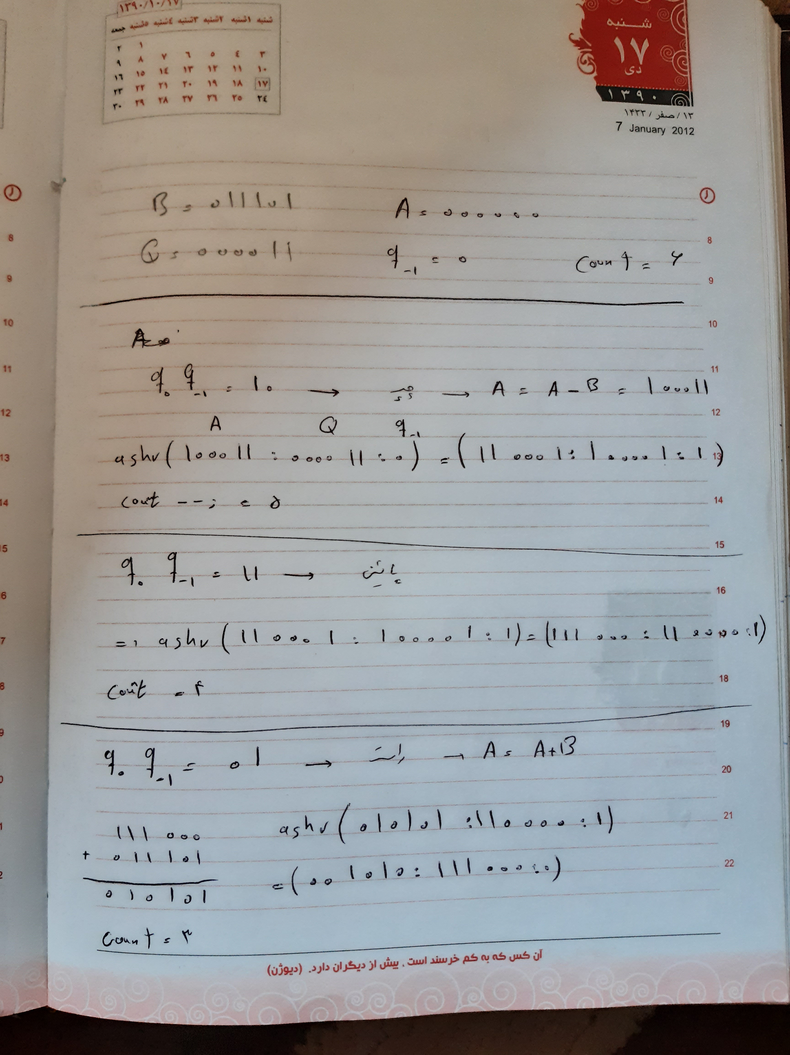
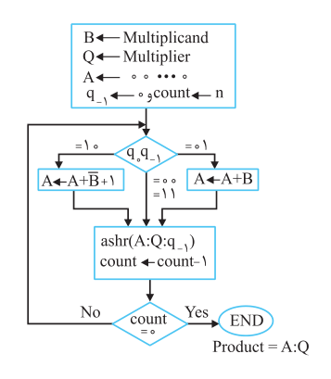
سوال 2:

Slide 5
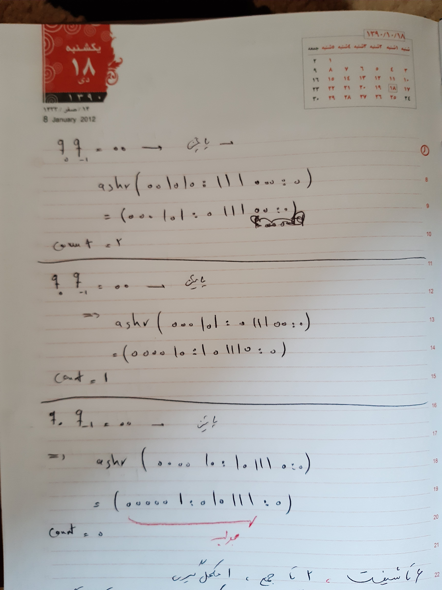

Slide 6

سوال 3:
$$1.25=1.01$$
$$3.45=11.0111…$$
$$2.75=10.11$$

Slide 7
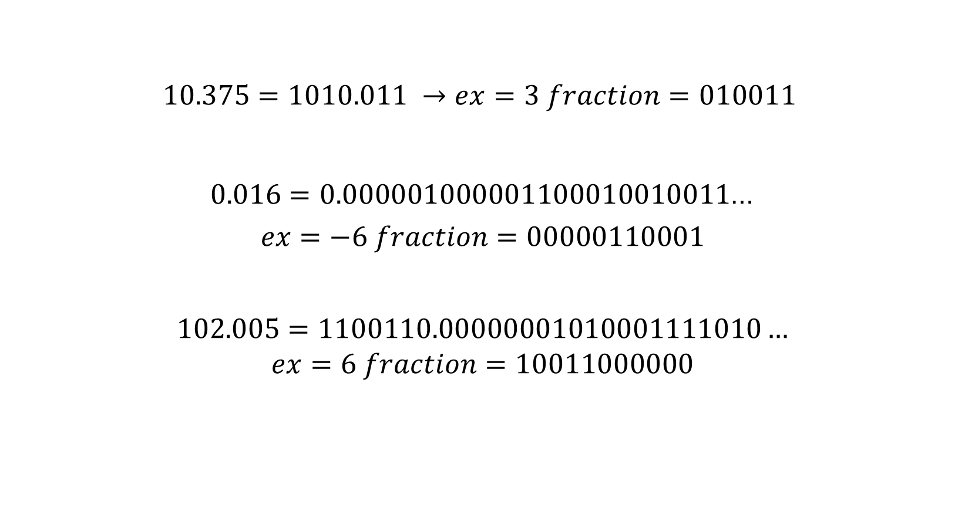
سوال 4:
$$10.375=1010.011 →ex=3 fraction=010011$$
$0.016=0.000001000001100010010011$…
$$ex=−6 fraction=00000110001$$
$$102.005=1100110.00000001010001111010…$$
$$ex=6 fraction=10011000000$$
01001100000 | 0011 | 1
00000110001 | 1010 | 0
10011000000 | 0110 | 0

